Slide 1
0. Software Testing and Delivery
——Course Information
贾经冬
北航软件学院
jiajingdong@buaa.edu.cn

Slide 2
Course Information
Date: Tuesday
Time:
  The eighth: 15:50 -16:35
  The ninth: 16:40 -17:25
Location: （一） 215

Slide 3
Grading
Assignments:
  1 or 2 assignment
  Testing report, and
  Programming assignments
An examination
Attendance

Slide 4
Independent Work
All work turned in must be of that individual student unless stated otherwise
Violations will result in zero credit to all students concerned.
Assignment must be submitted on time.

Slide 5
Textbook
No required text book
References
  P. C. Jorgensen, Software Testing: A Craftsman's Approach
  Pezze & Young, Software Testing and Analysis: Process, Principles and Techniques,
  Paul Ammann and Je Outt, Introduction to Software Testing, Cambridge University Press, Cambridge, UK,.
  G.J. Myers, The Art of Software Testing,
  Aditya P. Mathur, Foundations of Software Testing
Notes:
第一个是主要的，图书馆有翻译版本，但是我不建议大家买，因为翻译中错误多

Slide 6
Course Description
Study the principles, processes, techniques, and tools of software testing
Understand how to achieve high quality of software

Slide 7
Some Topics
Introduction to software testing
Static analysis and Inspection
Code smell
Functional testing
  EP, BVT, DT
Structural testing
Path testing
Dateflow testing
Combinational testing
Integration testing
  MM path
  Call Graph
OO testing
The process of testing
The concepts of delivery
Tool: pytest

Slide 8
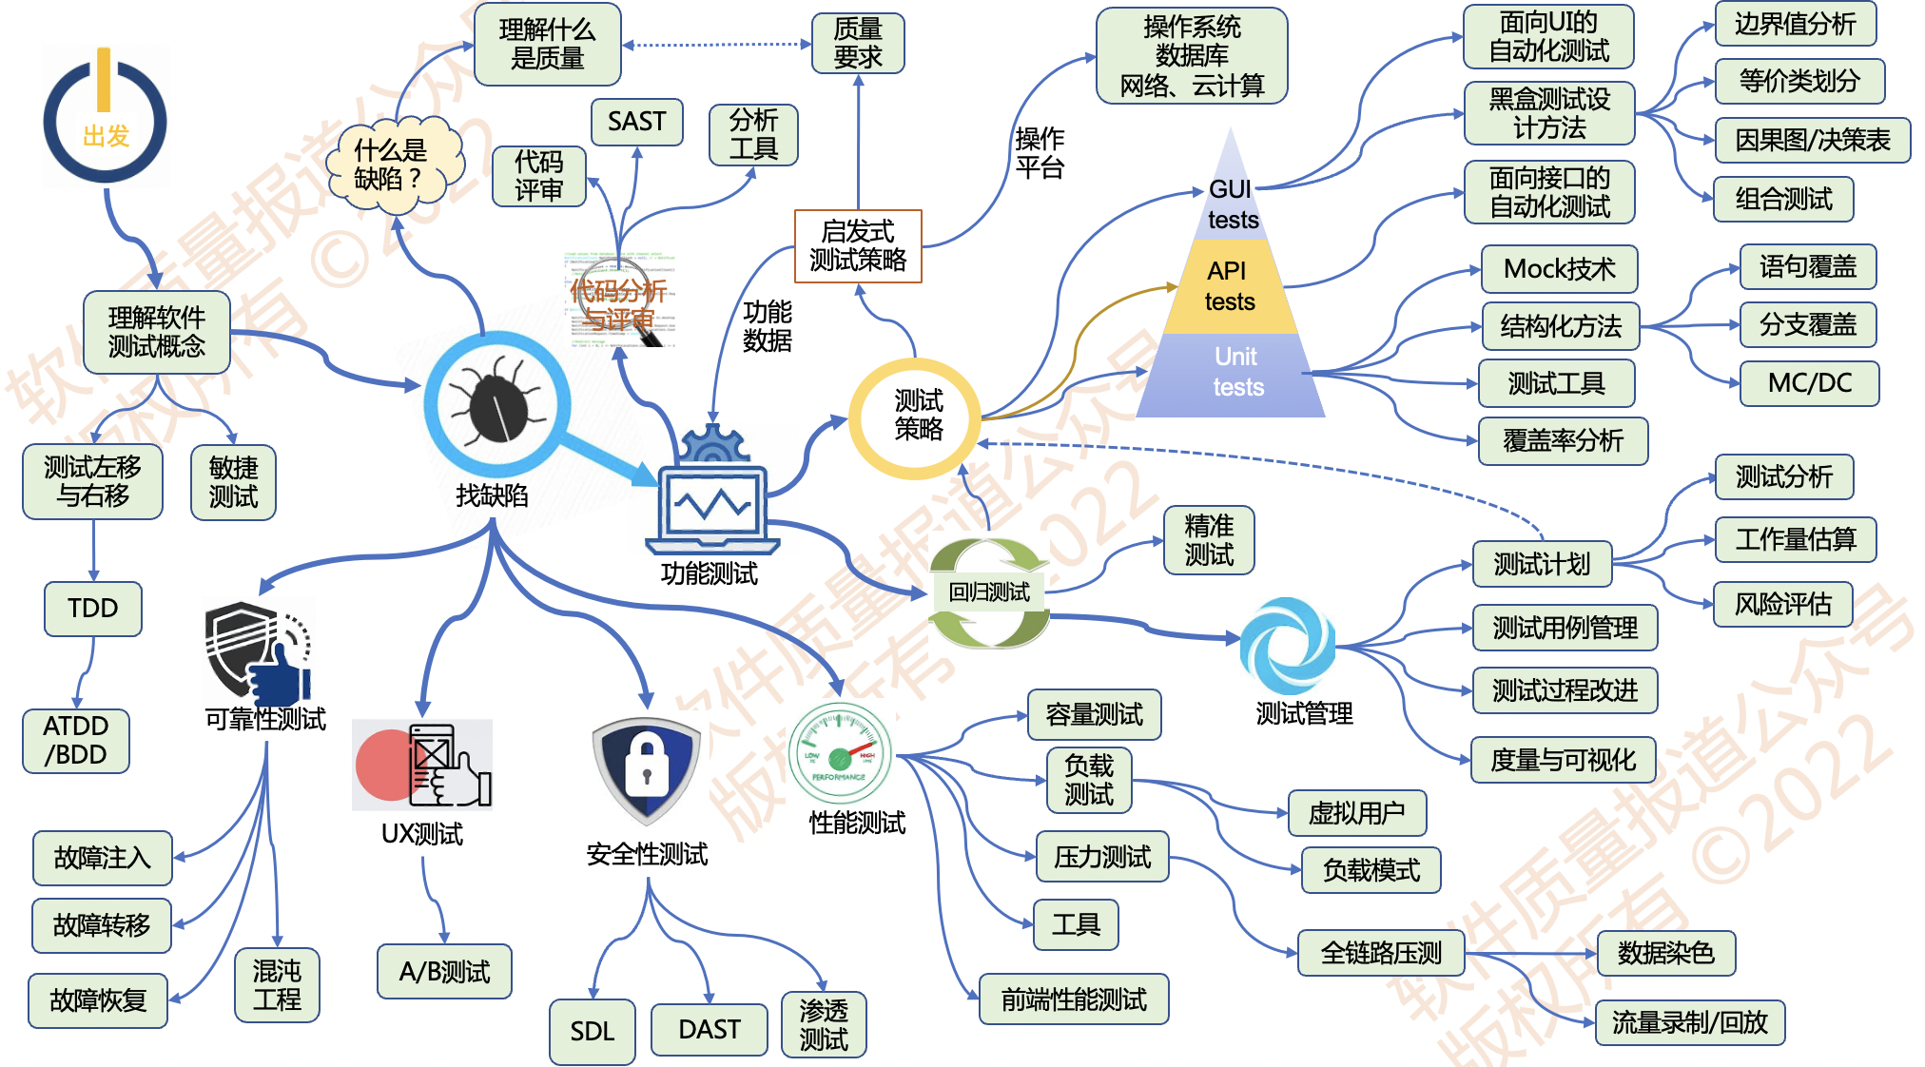
软件测试知识地图

